Slide 1
Recurrent Neural Network
Dr. Md. Golam Rabiul Alam
Associate Professor, BRAC University

Slide 2
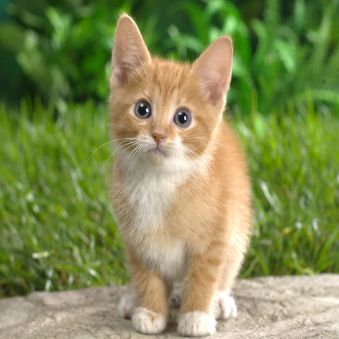
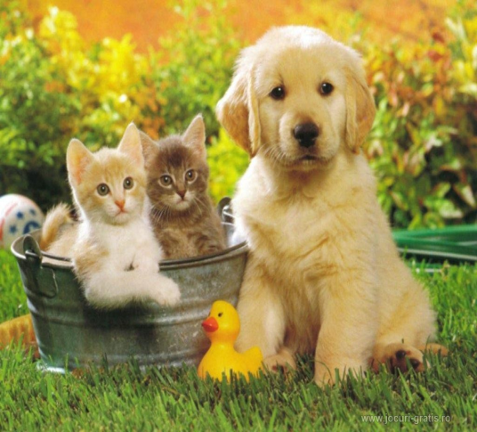

CNN is Better FOR:
Classification
Classification + Localization
Object Detection
Instance Segmentation
CAT
CAT
CAT, DOG, DUCK
CAT, DOG, DUCK
Single object
Multiple objects

Slide 3
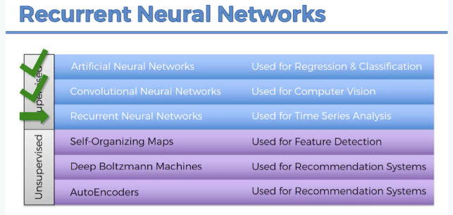
Recurrent Neural Network

Slide 4
RNN Background
Humans don’t start their thinking from scratch every second. As you read this paragraph, you understand each word based on your understanding of previous words. You don’t throw everything away and start thinking from scratch again. Your thoughts have persistence.

Slide 5
RNN Background
Traditional neural networks can’t do this, and it seems like a major shortcoming. For example, imagine you want to classify what kind of event is happening at every point in a movie. It’s unclear how a traditional neural network could use its reasoning about previous events in the film to inform later ones.
Recurrent neural networks address this issue. They are networks with loops in them, allowing information to persist.

Slide 6
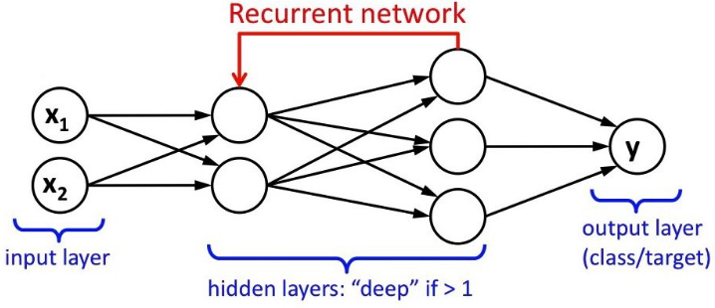
Recurrent Neural Network
Recurrent Neural Network (RNN) is a type of Neural Network where the output from previous step are fed as input to the current step.
Unlike feed-forward neural networks, RNNs can use their internal state (memory) to process sequences of inputs.
RNNs are designed to recognize a data's sequential characteristics and use patterns to predict the next likely scenario.
LSTMs are a powerful kind of RNN used for processing sequential data such as sound, time series (sensor) data or written natural language.

Slide 7
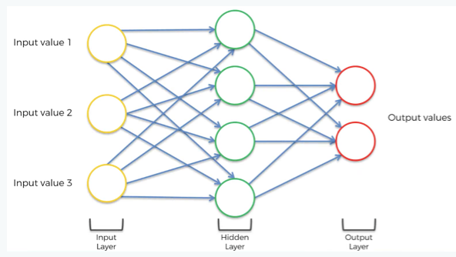
Neural Networks

Slide 8
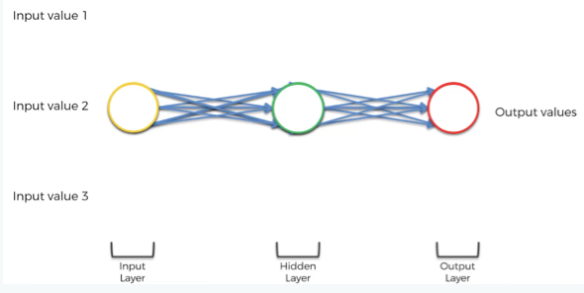
NN to RNN

Slide 9
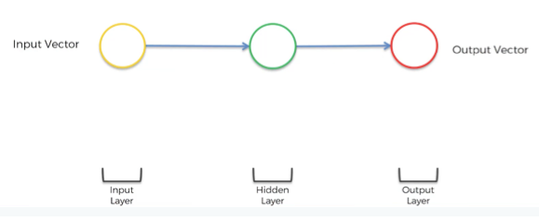
NN to RNN

Slide 10
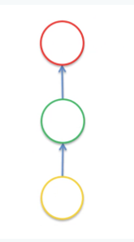
NN to RNN

Slide 11
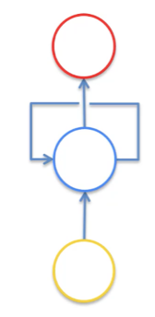
NN to RNN

Slide 12
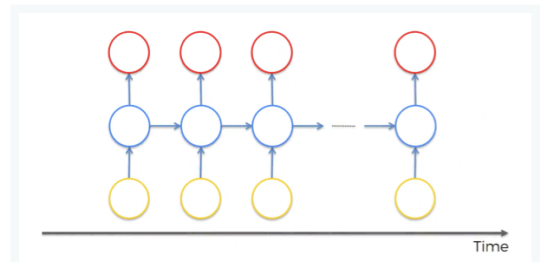
NN to RNN

Slide 13
NN to RNN
So, we’ve got inputs, hidden layer and outputs as usually but now the neurons are also connected to themselves through time.
The idea behind RNNs is that the neurons have some sort of short-term memory providing them with the possibility to remember, what was in this neuron just previously. Thus, the neurons can pass information on to themselves in the future and analyze things.

Slide 14
Types of RNN
(based on input to output mapping)

Slide 15
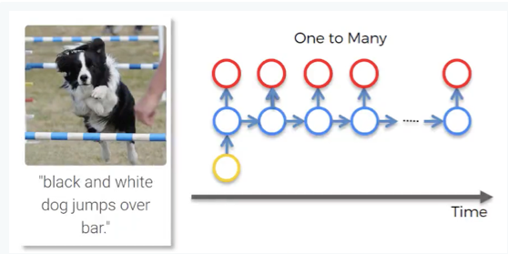
One to Many

Slide 16
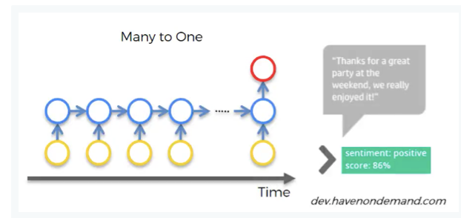
Many to One

Slide 17
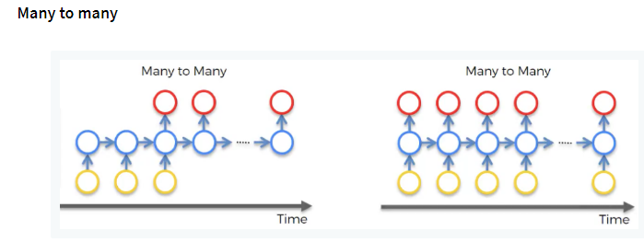
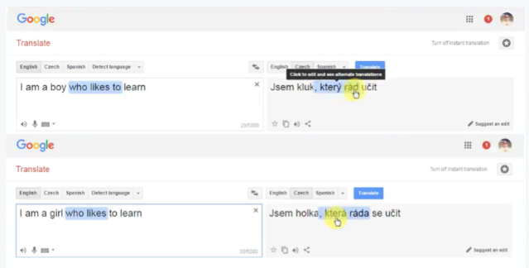
Many to many
https://arstechnica.com/gaming/2016/06/an-ai-wrote-this-movie-and-its-strangely-moving/

Slide 18
RNN
Sometimes, we only need to look at recent information to perform the present task.
For example, consider a language model trying to predict the next word based on the previous ones. If we are trying to predict the last word in “the clouds are in the sky,” we don’t need any further context – it’s pretty obvious the next word is going to be sky.

Slide 19
RNN is unable to learn Long-term dependencies
But there are also cases where we need more context. Consider trying to predict the last word in the text “I grew up in France… I speak fluent French.” Recent information suggests that the next word is probably the name of a language, but if we want to narrow down which language, we need the context of France, from further back.
Unfortunately, as that gap grows, the pure RNNs become unable to learn to connect the information.

Slide 20
Vanishing Gradient Problem of RNN
As you remember, the gradient descent algorithm finds the global minimum of the cost function that is going to be an optimal setup for the network.
As you might also recall, information travels through the neural network from input neurons to the output neurons, while the error is calculated and propagated back through the network to update the weights.
It works quite similarly for RNNs, but here we’ve got a little bit more going on.

Slide 21
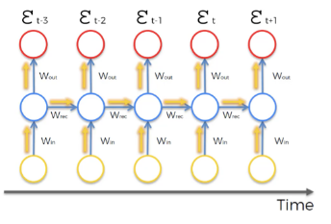
Vanishing Gradient Problem of RNN
It works quite similarly for RNNs, but here we’ve got a little bit more going on.
Firstly, information travels through time in RNNs, which means that information from previous time points is used as input for the next time points.
Secondly, you can calculate the cost function, or your error, at each time point.

Slide 22
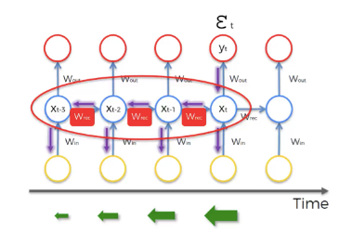

Vanishing Gradient Problem of RNN

Slide 23
Vanishing Gradient Problem of RNN
As we propagate the error through the network, it has to go through the unraveled temporal loop – the hidden layers connected to themselves in time by the means of weights wrec.
Because this weight is applied many-many times on top of itself, that causes the gradient to decline rapidly.
As a result, weights of the layers on the very far left are updated much slower than the weights of the layers on the far right.
This creates a domino effect because the weights of the far-left layers define the inputs to the far-right layers.
Therefore, the whole training of the network suffers, and that is called the problem of the vanishing gradient.

Slide 24
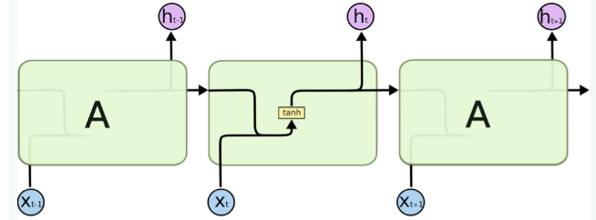
Long-Short-Term-Memory (LSTM)
Long short-term memory (LSTM) network is the most popular solution to the vanishing gradient problem.
Long Short Term Memory networks – usually just called “LSTMs” – are a special kind of RNN, capable of learning long-term dependencies.
Fig: The repeating module in a standard RNN contains a single layer.

Slide 25
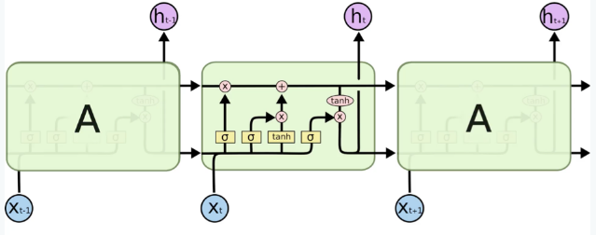
LSTM
LSTMs also have this chain like structure, but the repeating module has a different structure. Instead of having a single neural network layer, there are four, interacting in a very special way
Fig: The repeating module in an LSTM contains four interacting layers.
We can say that we have a vanishing gradient if wrec < 1 and exploding gradient if wrec > 1
The easiest and fastest solution will be to make wrec = 1. That’s exactly what was done in LSTMs. In general, making recurrent weight equal to one is the main idea behind LSTMs.

Slide 26
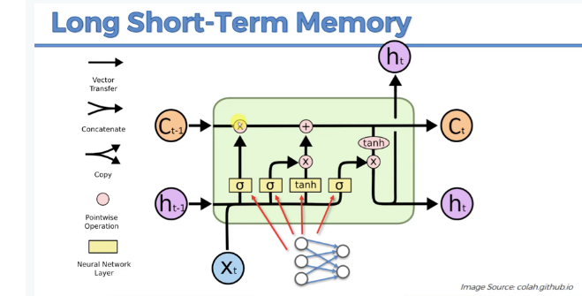
LSTM
C_{t-1} : stands for the input from a memory cell in time point t;
x_{t} : is an input in time point t;
h_{t} : is an output in time point t that goes to both the output layer and the hidden layer in the next time point.

Slide 27
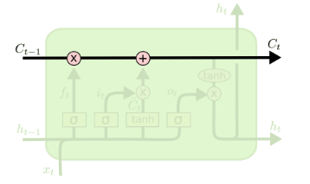
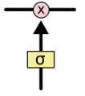
LSTM
The key to LSTMs is the cell state, the horizontal line running through the top of the diagram.
The cell state is kind of like a conveyor belt. It runs straight down the entire chain, with only some minor linear interactions. It’s very easy for information to just flow along it unchanged.
The LSTM does have the ability to remove or add information to the cell state, carefully regulated by structures called gates.
Gates are a way to optionally let information through. They are composed out of a sigmoid neural net layer and a pointwise multiplication operation.
The sigmoid layer outputs numbers between zero and one, describing how much of each component should be let through. A value of zero means “let nothing through,” while a value of one means “let everything through!”

Slide 28
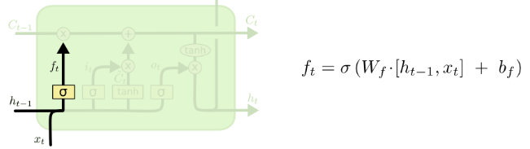
LSTM [Step 1]
The first step in our LSTM is to decide what information we’re going to throw away from the cell state.
This decision is made by a sigmoid layer called the “forget gate layer.” It looks at h_{t−1} and x_{t}, and outputs a number between 0 and 1 for each number in the cell state C_{t−1}. A 1 represents “completely keep this” while a 0 represents “completely get rid of this.”
Let’s go back to our example of a language model trying to predict the next word based on all the previous ones. In such a problem, the cell state might include the gender of the present subject, so that the correct pronouns can be used. When we see a new subject, we want to forget the gender of the old subject.

Slide 29
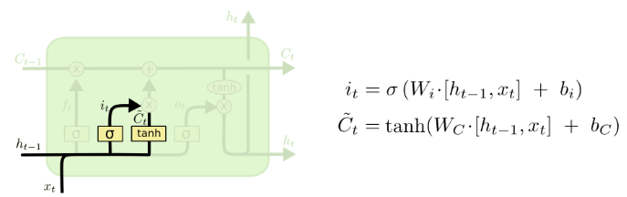
LSTM [Step 2]
The next step is to decide what new information we’re going to store in the cell state. This has two parts:
First, a sigmoid layer called the “input gate layer or memory valve” decides which values we’ll update.
Next, a tanh layer creates a vector of new candidate values, , that could be added to the state.
In the next step, we’ll combine these two to create an update to the state.
In the example of our language model, we’d want to add the gender of the new subject to the cell state, to replace the old one we’re forgetting.

Slide 30
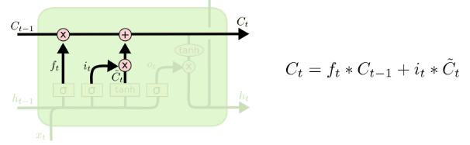
LSTM [Step 3]
It’s now time to update the old cell state, C_{t−1}, into the new cell state C_{t}. The previous steps already decided what to do, we just need to actually do it.
We multiply the old state by f_{t}, forgetting the things we decided to forget earlier. Then we add i_{t} ∗ . This is the new candidate values, scaled by how much we decided to update each state value.
In the case of the language model, this is where we’d actually drop the information about the old subject’s gender and add the new information, as we decided in the previous steps.

Slide 31
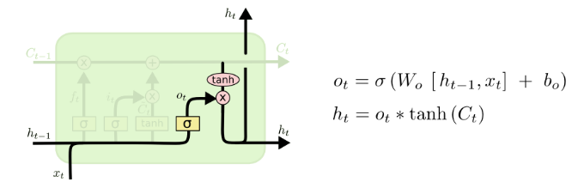
LSTM [Step 4]
Finally, we need to decide what we’re going to output. This output will be based on our cell state, but will be a filtered version.
First, we run a sigmoid layer which decides what parts of the cell state we’re going to output. Then, we put the cell state through tanh (to push the values to be between −1 and 1) and multiply it by the output of the sigmoid gate, so that we only output the parts we decided to.
For the language model example, since it just saw a subject, it might want to output information relevant to a verb, in case that’s what is coming next. For example, it might output whether the subject is singular or plural, so that we know what form a verb should be conjugated into if that’s what follows next.

Slide 32
LSTM operations (Summarized)
Point-wise operation: There are five point-wise operations on the scheme and they are of three types:
“x” or valves: (forget valve, memory valve, and output valve) – points on the scheme, where you can open your pipeline for the flow, close it or open to some extent. For instance, forget valve at the top left of the above scheme is controlled by the layer operation s. Based on a decision of this sigmoid activation function (ranging from 0 to 1), the valve will be closed, open or closed to some extent. If it’s open, memory flows freely from c_{t-1} to c_{t}. If it’s closed, then memory is cut off, and probably new memory will be added further in the pipeline, where another point-wise operation is depicted.
“+” – t-shaped joint, where you have memory going through and you can add additional memory if the memory valve below this joint is open.
“tanh” – responsible for transforming the value to be within the range from -1 to 1 (required due to certain mathematical considerations).

Slide 33
LSTM Architecture (Summarized)
We’ve got new value x_{t} and value from the previous node h_{t-1} coming in.
These values are combined together and go through the sigmoid activation function, where it is decided if the forget valve should be open, closed or open to some extent.
The same values, or actually vectors of values, go in parallel through another layer operation “tanh”, where it is decided what value we’re going to pass to the memory pipeline, and also sigmoid layer operation, where it is decided, if that value is going to be passed to the memory pipeline and to what extent.
Then, we have a memory flowing through the top pipeline. If we have forget valve open and memory valve closed then the memory will not change. Otherwise, if we have forget valve closed and memory valve open, the memory will be updated completely.
Finally, we’ve got x_{t} and h_{t-1} combined to decide what part of the memory pipeline is going to become the output of this module.

Slide 34
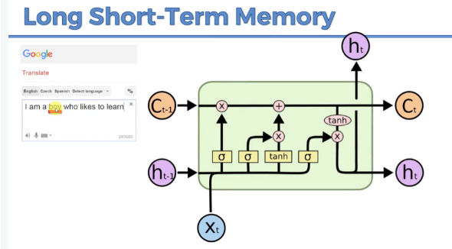
LSTM

Slide 35
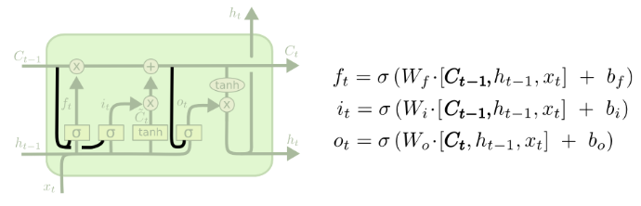
LSTM Variations (1)
One popular LSTM variant, introduced by Gers & Schmidhuber (2000), is adding “peephole connections.” This means that we let the gate layers look at the cell state.
The above diagram adds peepholes to all the gates, but many papers will give some peepholes and not others.

Slide 36
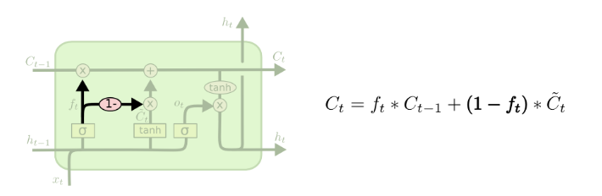
LSTM Variations (2)
Another variation is to use coupled forget and input gates. Instead of separately deciding what to forget and what we should add new information to, we make those decisions together. We only forget when we’re going to input something in its place. We only input new values to the state when we forget something older.

Slide 37
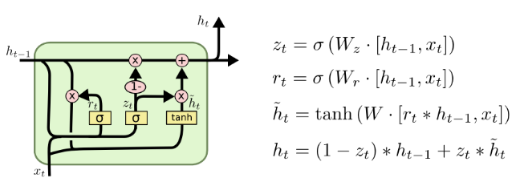
LSTM Variations (3)
A slightly more dramatic variation on the LSTM is the Gated Recurrent Unit, or GRU, introduced by Cho, et al. (2014). It combines the forget and input gates into a single “update gate.” It also merges the cell state and hidden state, and makes some other changes. The resulting model is simpler than standard LSTM models, and has been growing increasingly popular.

Slide 38

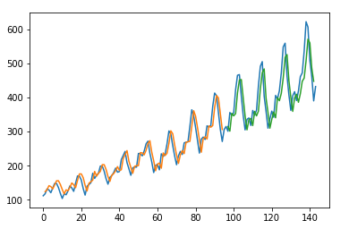
LSTM Implementation
Predicting the number of international airline passengers in units of 1,000. The data ranges from January 1949 to December 1960, or 12 years, with 144 observations.
The dataset is available for free from the DataMarket webpage as a CSV download with the filename “international-airline-passengers.csv“.

Slide 39
References
http://colah.github.io/posts/2015-08-Understanding-LSTMs/
https://www.superdatascience.com/blogs/the-ultimate-guide-to-recurrent-neural-networks-rnn
https://adventuresinmachinelearning.com/page/3/
https://adventuresinmachinelearning.com/keras-lstm-tutorial/
https://github.com/rasbt/python-machine-learning-book-2nd-edition/blob/master/code/ch16/ch16.ipynb
https://machinelearningmastery.com/time-series-prediction-lstm-recurrent-neural-networks-python-keras/

